Slide 1
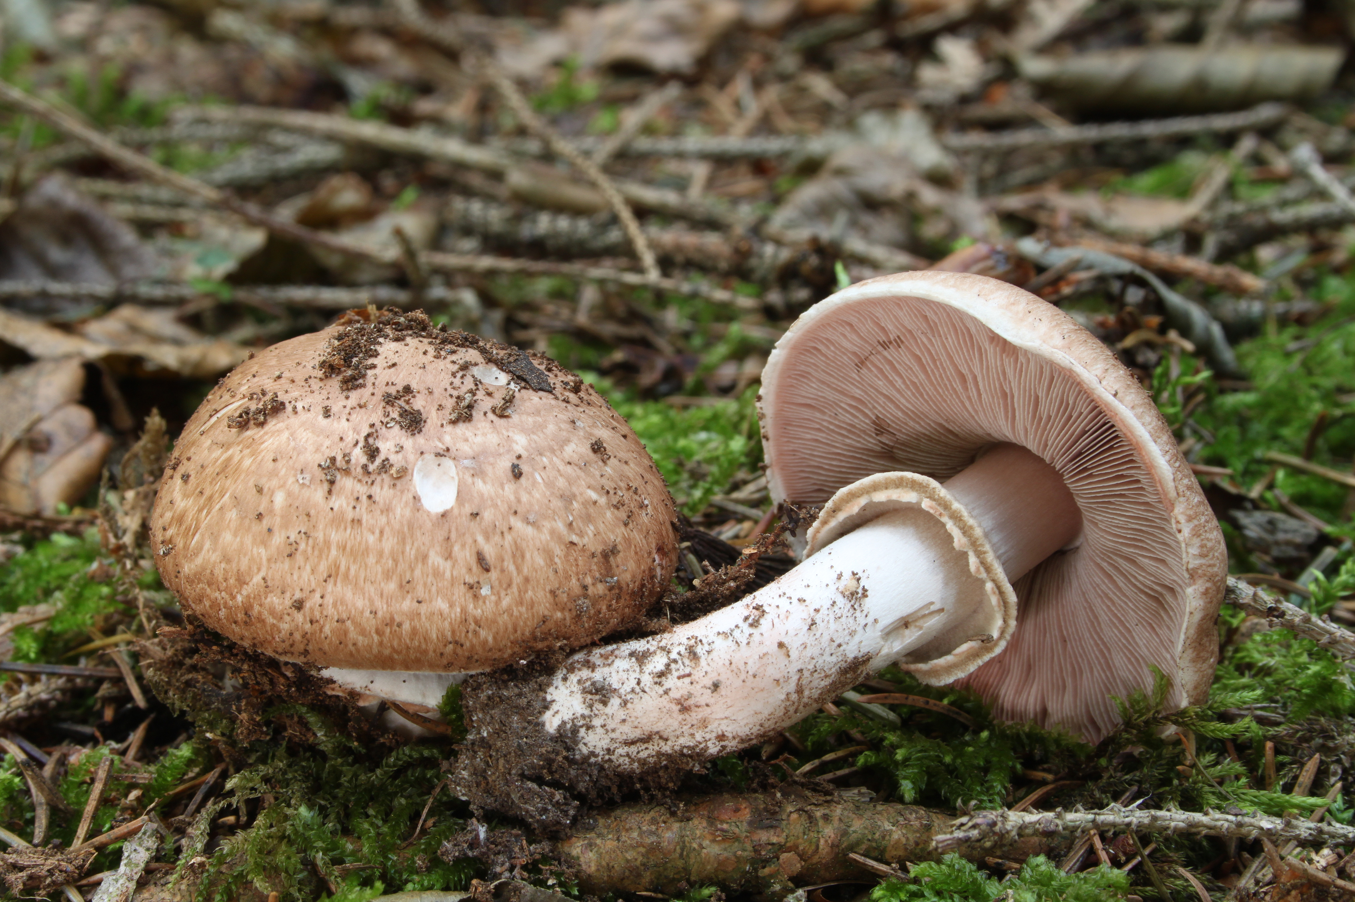
The Prediction of Mushroom Edibility Using Machine Learning
Benjamin W. Sturm
bwsturm@gmail.com
May 16, 2018
Notes:
Hello. I’m going to be presenting on the prediction of mushroom edibility using machine learning.

Slide 2

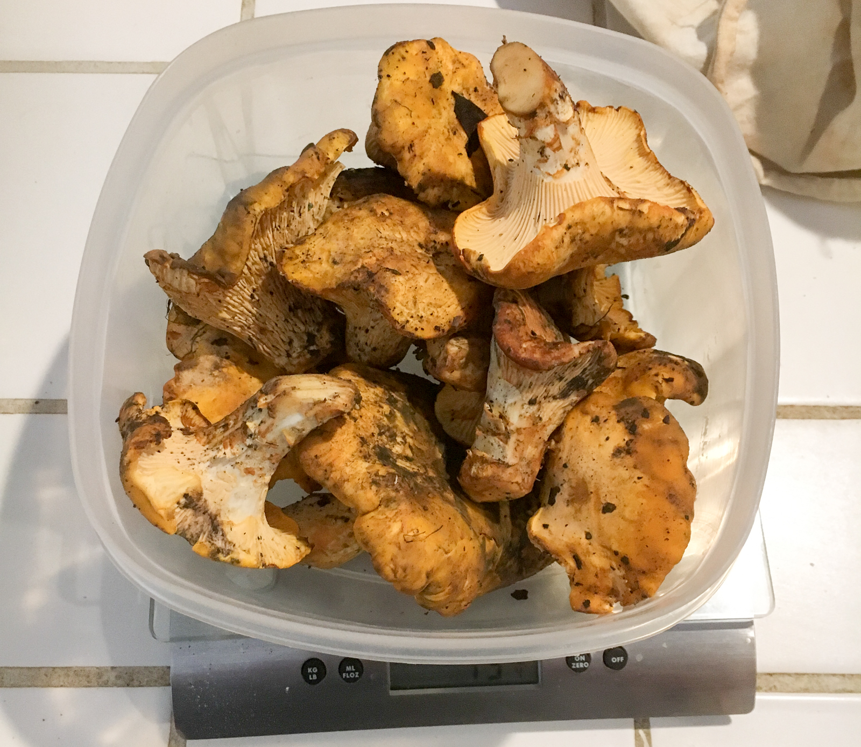
Hunting edible mushrooms in the wild can be an exciting and rewarding process
Hunter-Gatherers
The Trophy
Notes:
Hunting for edible mushrooms is an activity that is quite popular in the Bay Area and is also something that I personally really enjoy doing.
Click
Here is a picture of my son and I out on a recent mushroom hunting expedition.
Click
And here is a picture of our trophy. These are chanterelle mushrooms. Chanterelles are one of my favorite mushrooms to hunt for and they are easily identifiable and are also delicious.

Slide 3
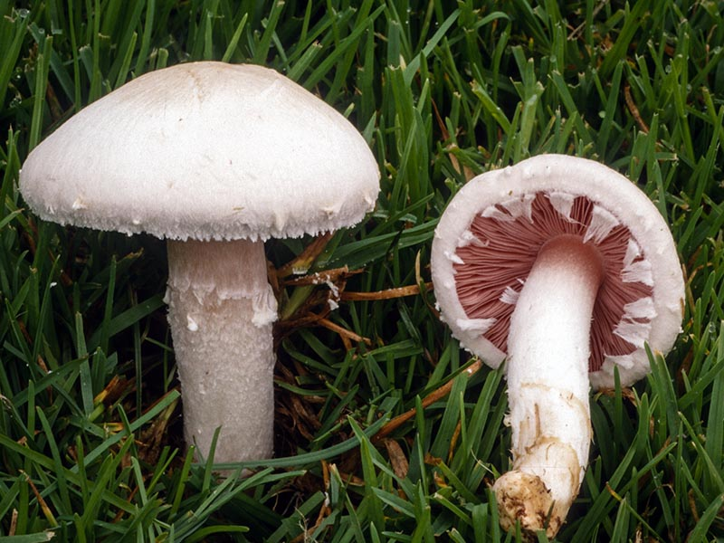
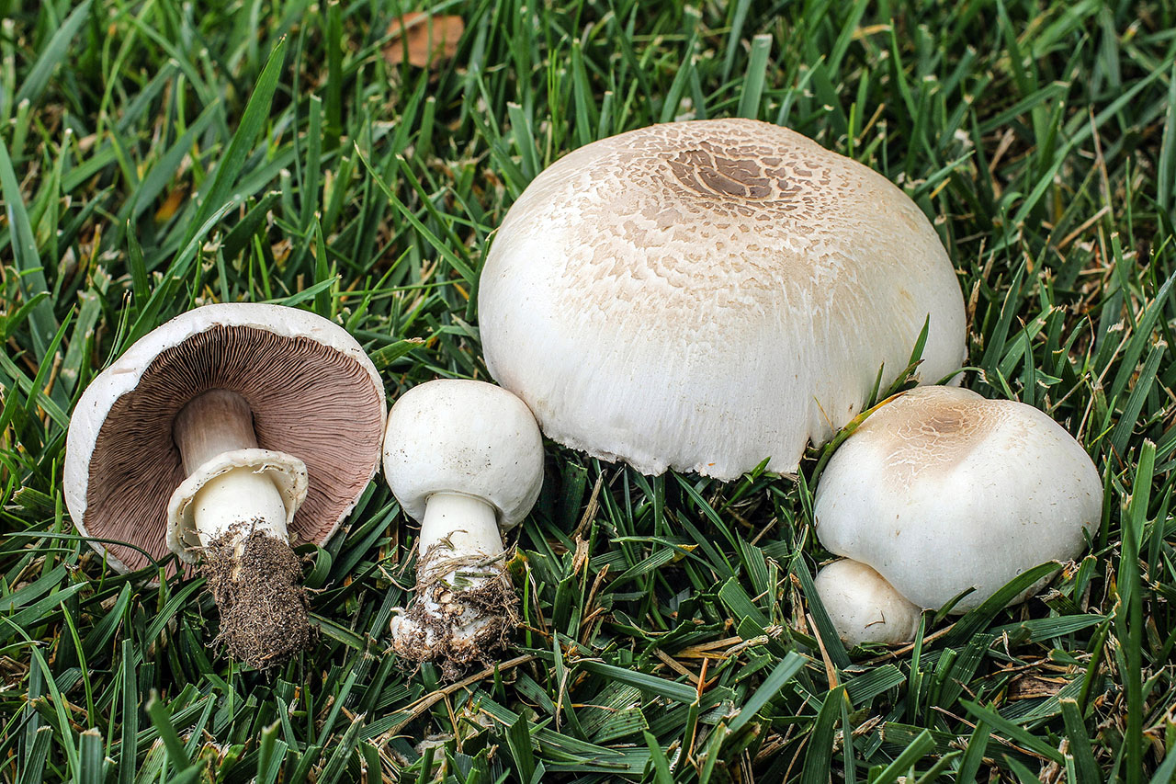
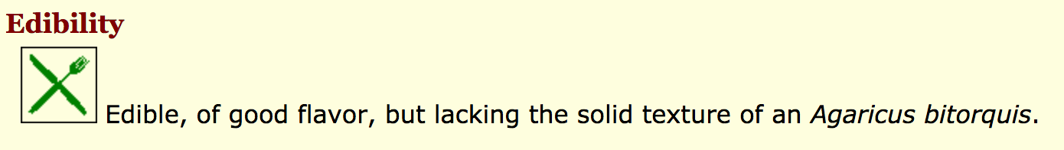
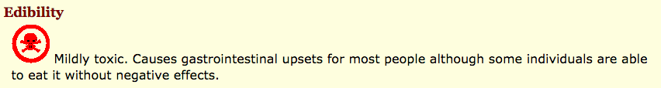
Wouldn’t it be great if you could determine whether a mushroom you encounter in nature is poisonous or not with machine learning?
Agaricus Campestris (Non-poisonous)
Agaricus Californicus (Poisonous)
Notes:
So wouldn’t it be great if you could determine whether a mushroom is poisonous or not with machine learning? Here are two mushroom species. The one on the left, agaricus campestris, is edible and the one on the right, agaricus californicus, is poisonous. These mushrooms have many similar traits and appear similarly, but the results of eating both of these mushrooms will be very different.
click
Here is some descriptions I found from Mykoweb, which states that Agaricus Californicus is mildly toxic and may cause G.I. upsets.

Slide 4
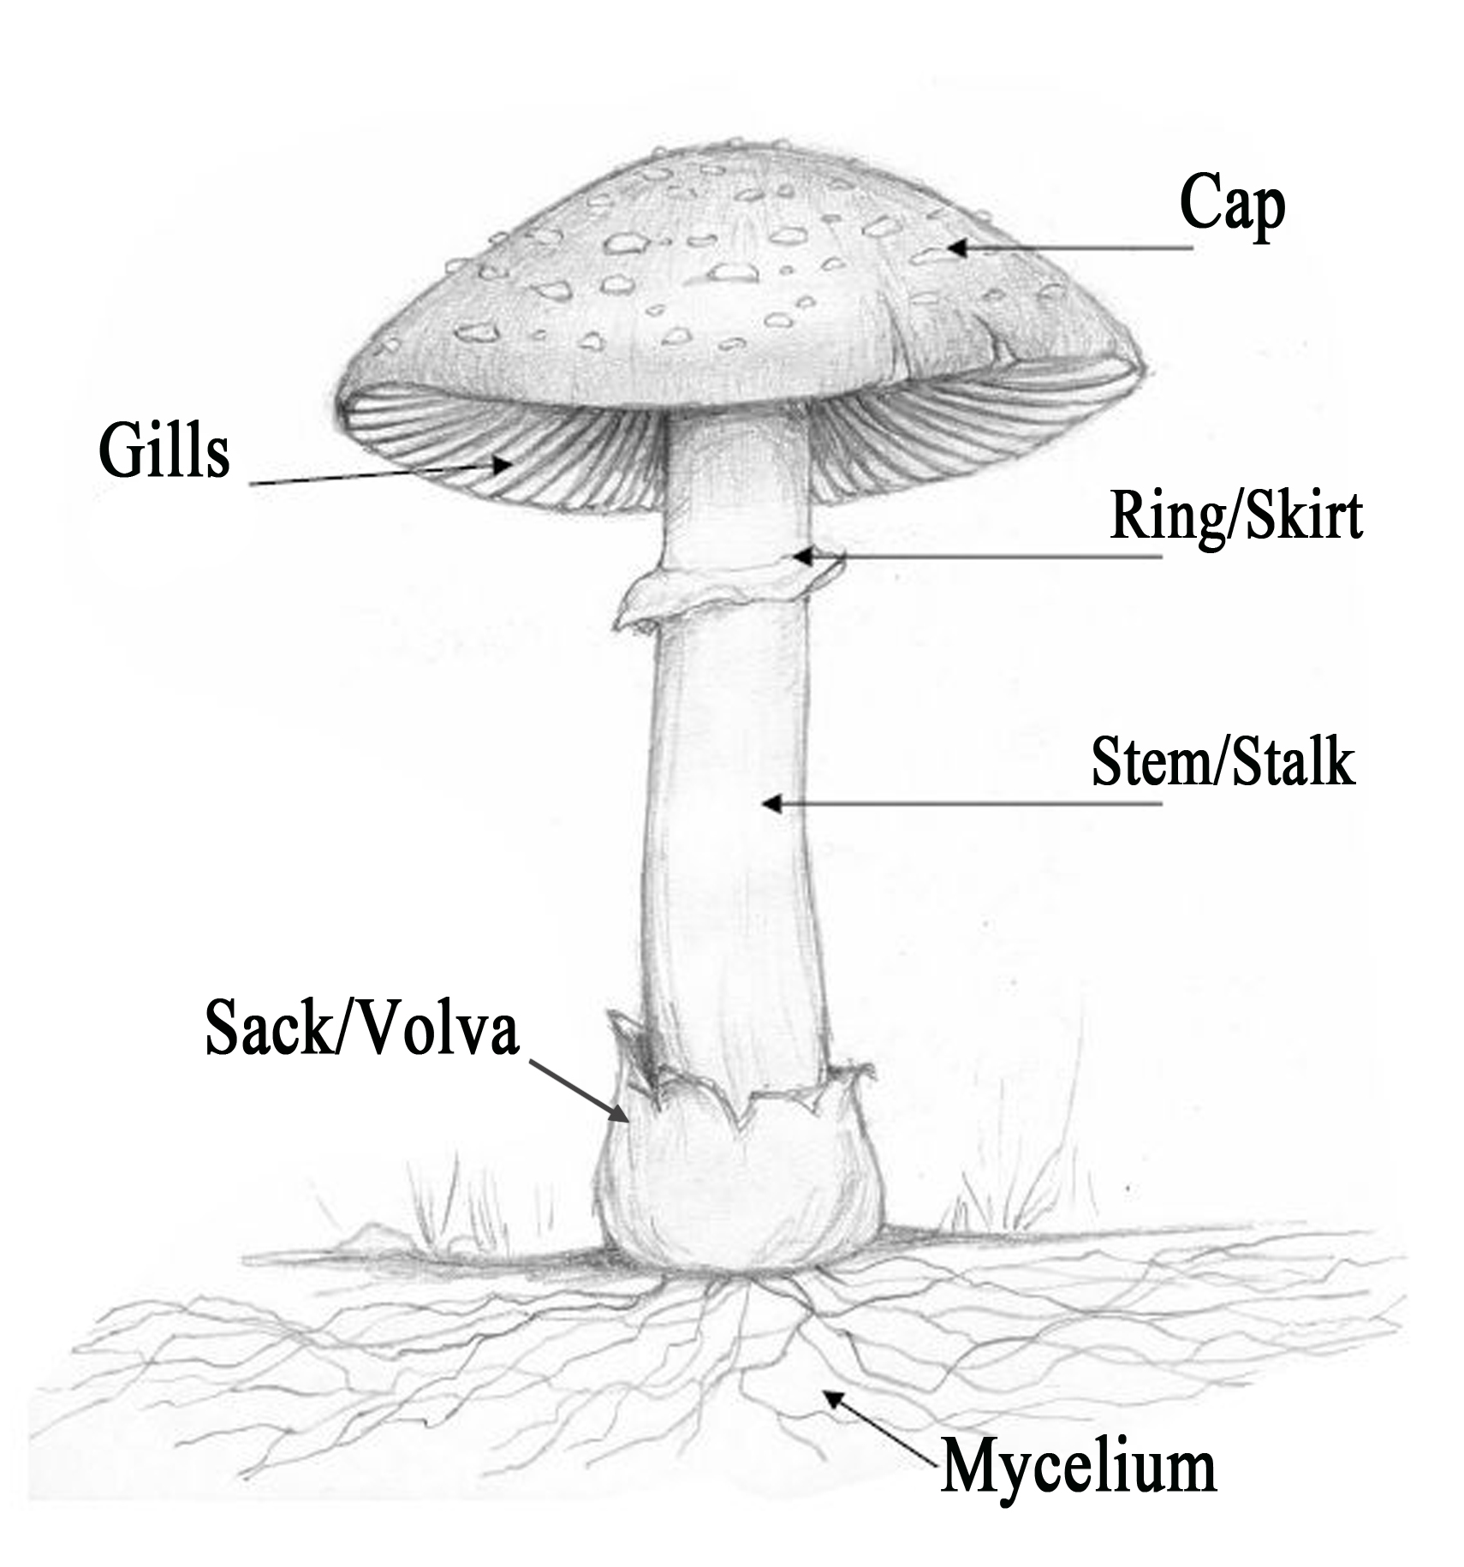
Wouldn’t it be great if you could determine whether a mushroom you encounter in nature is poisonous or not with machine learning?
Basic mushroom anatomy
 | Agaricus campestris (non-poisonous) | Agaricus californicus (poisonous)
cap color | white | whitish to brown
gill color | pink (young), chocolate brown (mature) | pink (young), chocolate brown (mature)
ring | no | yes
bruises? | no | yes
habitat | grass | forest and grass
odor | mild, mushroomy | antiseptic
Notes:
If we examine a few key attributes for each of these mushrooms, we can see that there are some differences. For this table, in the first column we have the non-poisonous mushroom and in the second column we have the poisonous variety. The cap color and gill color are similar for both of these mushrooms. However, the poisonous one has a ring and bruises, whereas the nonpoisonous one doesn’t have either of these traits. In addition, the poisonous one has an antiseptic odor whereas the nonpoisonous one has a mild or mushroomy odor.

Slide 5
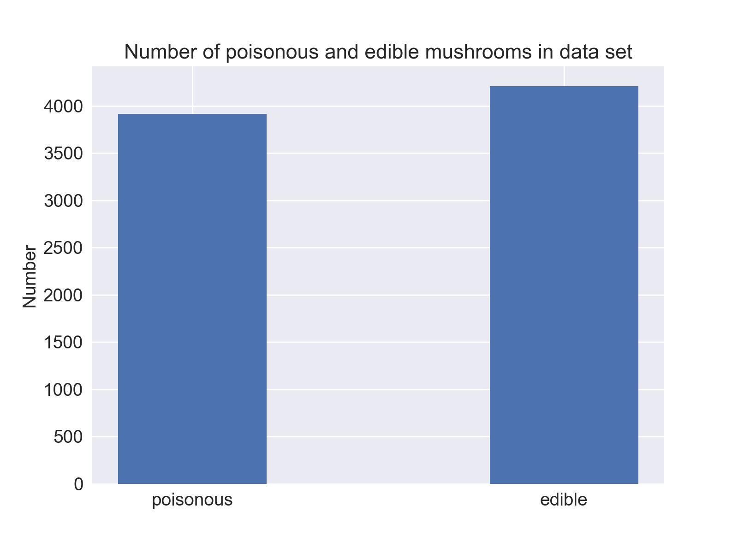
For this project, I used the UCI Mushroom Data Set to determine if machine learning could be used to classify the edibility of mushrooms
The data set consists of mushrooms from 2 different families only (Agaricus, Lepiota)
23 individual species of mushrooms
Number of instances = 8124
Number of features = 22
All features are categorical
Target variable is edibility
52% edible
48% non-edible
Notes:
To answer the question if we can determine whether a mushroom is poisonous or not with machine learning, I used the UC Irvine Mushroom Data Set. Some characteristics about this data set are that it consists of mushrooms from 2 different families (Agaricus and Lepiota). These are all gilled mushrooms. For instance, the Agaricus family contains the white button mushroom that you would find in your local grocery store.
Data set contains 23 individual species of mushrooms with 8124 total instances.
There are a total of 22 input features, which are all categorical.
The target variable is edibility.
As you can see in the bar plot, this data set is very balanced.

Slide 6
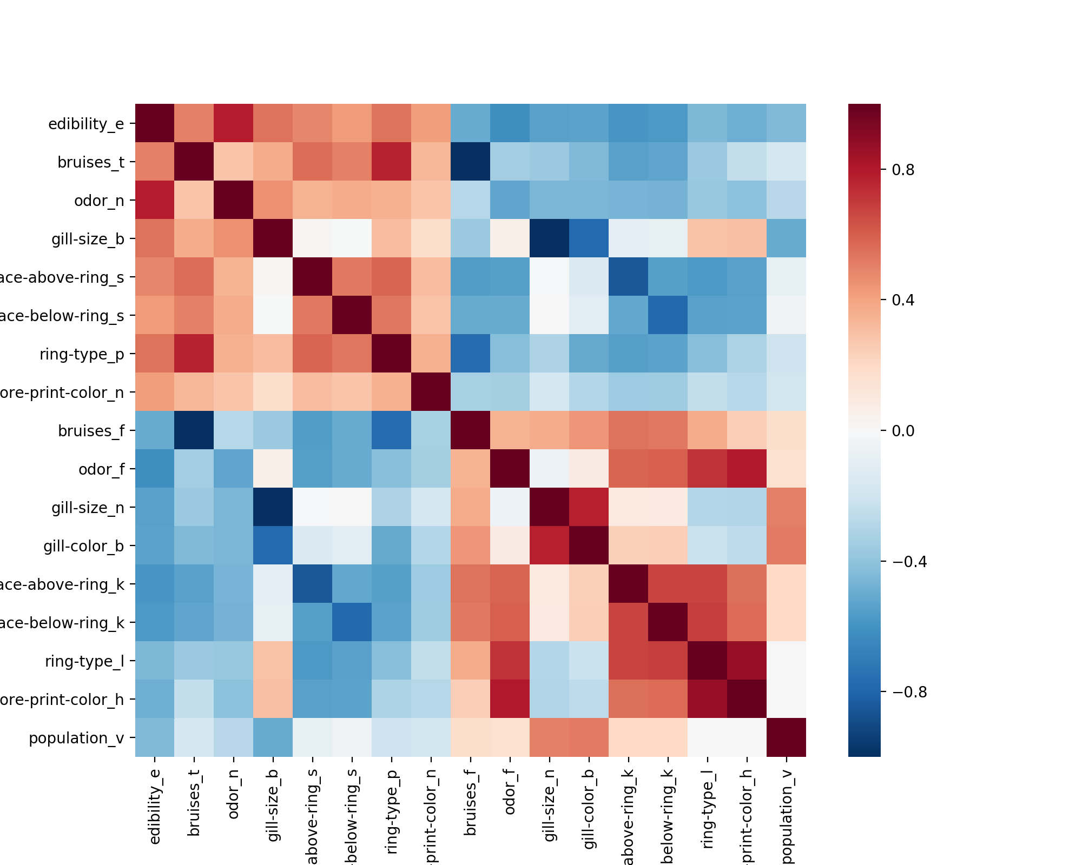
Certain features are strongly correlated with edibility
Corr = .786
Corr = -.624
Edibility
Odor - None
Odor - Foul
Notes:
Certain features are quite strongly correlated with edibility. This is a correlation heatmap of the features that are most strong correlated or anti-correlated with edibility.
Click
Two features that are strongly correlated with edibility are when the Odor is None or when the Odor is Foul.

Slide 7
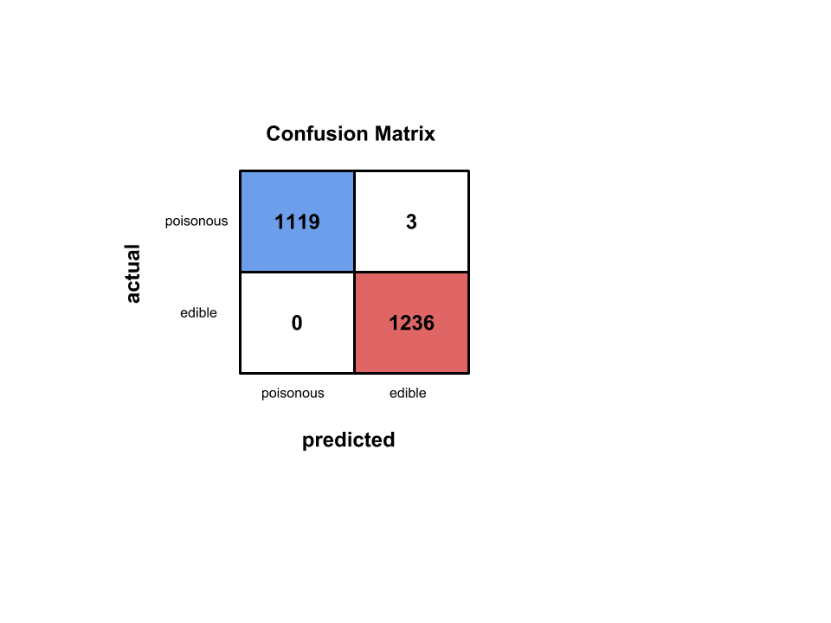
Baseline model using logistic regression has near perfect accuracy
Logistic Regression Results with default parameters
Model | Precision | Recall | Accuracy | AUC
Logistic Regression | 0.998 | 1.000 | 0.999 | 1.000
Notes:
The first model I ran, which was logistic regression, had really good results. The accuracy was 0.999. The confusion matrix shows that we did a really good job in terms of correctly classifying edible and poisonous mushrooms. However, we did misclassify 3 poisonous mushrooms as edible, so there is still some room for improvement.

Slide 8
Which features are most important for predicting edibility?
Logistic regression important coefficients
For these 2 families of mushrooms, odor is one of the most important features
Odors indicating edibility
n = None, l = anise, a = almond
Odors indicating poisonousness
p = pungent, f = foul, c = creosote
Also, don’t eat mushrooms in which the spore print is green
Feature | β
odor_n | 4.064
odor_l | 2.656
odor_a | 2.647
gill-size_b | 1.959
gill-spacing_c | -1.522
stalk-surface-above-ring_k | -1.665
gill-color_b | -1.799
gill-size_n | -2.067
odor_p | -2.253
stalk-root_b | -2.287
odor_f | -2.608
odor_c | -2.638
spore-print-color_r | -3.331
Predictive of
edibility
Predictive of
poisonousness
Notes:
Which features are most important for predicting edibility? We can answer that question by examining the beta coefficients found after running the logistic regression model. The most important features are summarized in this table.
Click
The positive features are predictive of the mushroom being edible and the negative features are predictive of the mushroom being poisonous.
Click

Slide 9
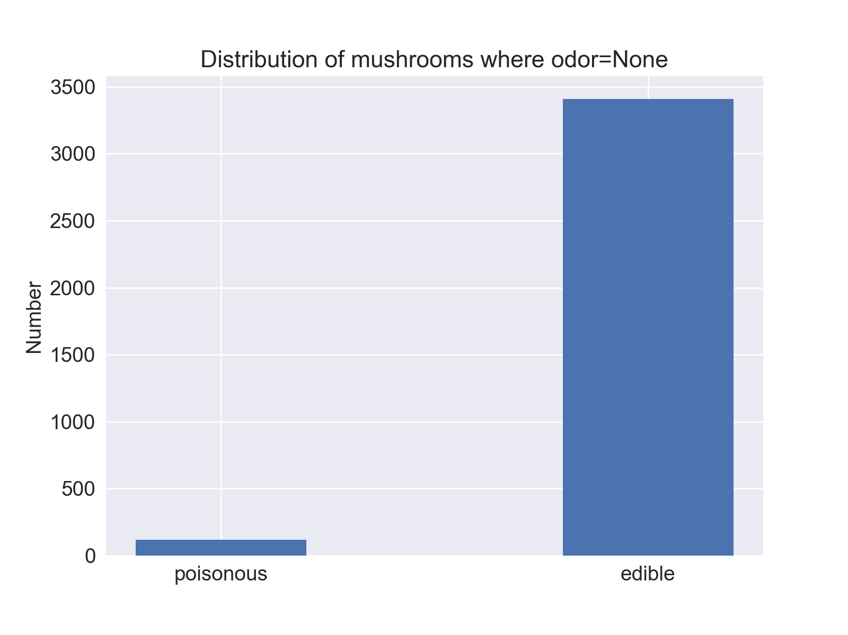
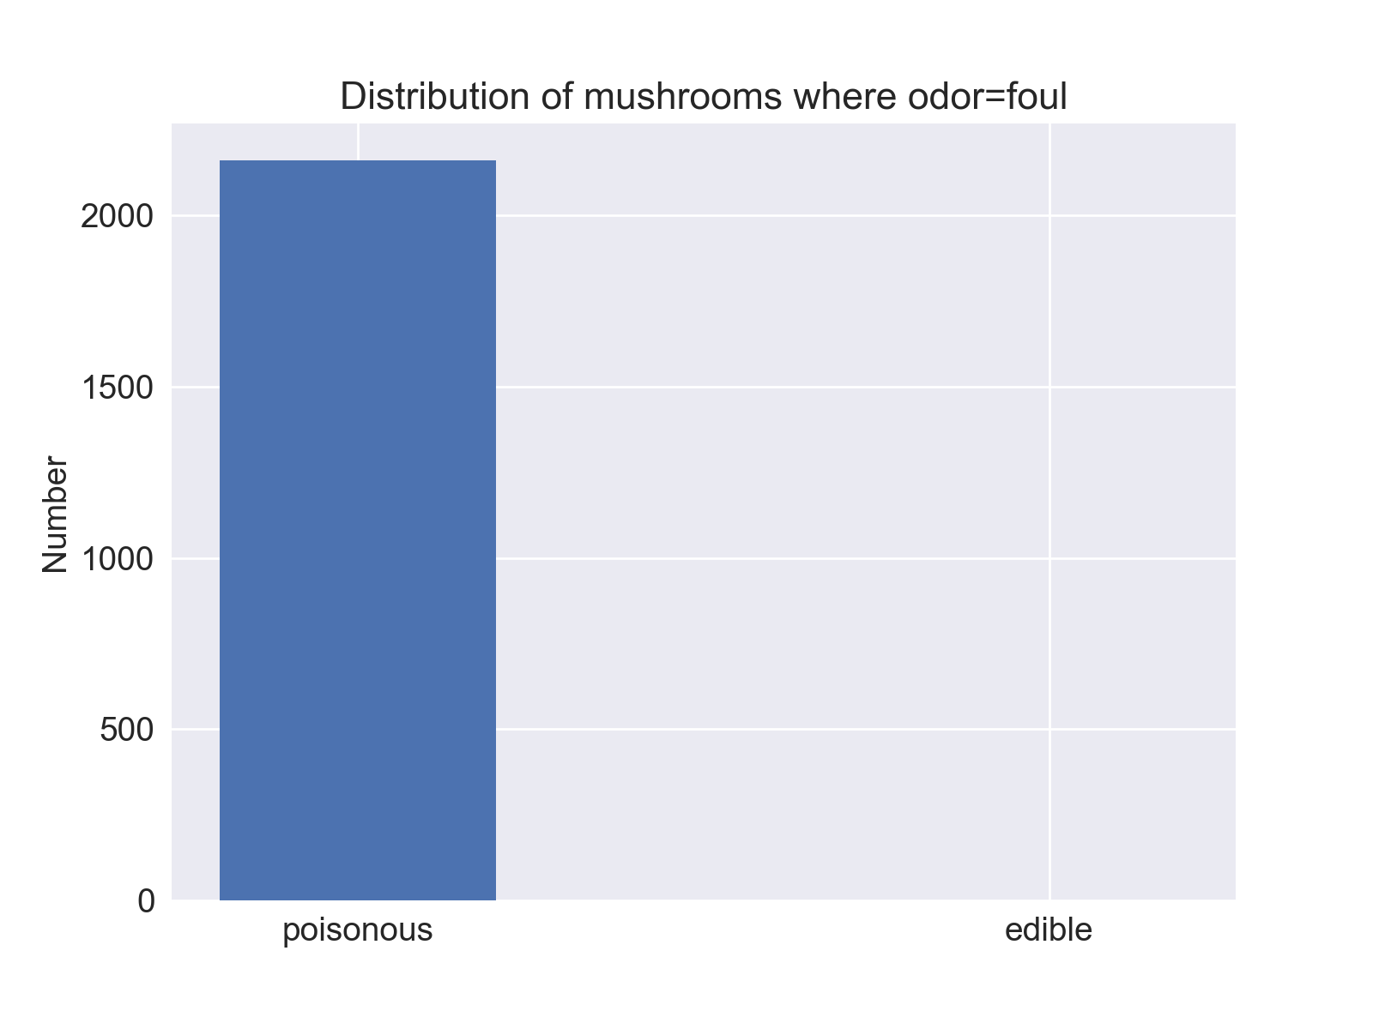
Many mushrooms can be correctly classified just based on two features
β = 4.064
β = -2.608
3.4%
96.6%
100%
0%
Notes:
Many mushrooms can be correctly classified just based on two features. Here I’m showing 2 bar plots. One for the case where odor=None (this has a positive beta coefficient). The other for the case where odor=foul (this has a negative beta coefficient). Clearly, these two features do a good job at separating edible from poisonous mushrooms.

Slide 10

Other models resulted in perfect accuracy
Model | Precision | Recall | Accuracy | AUC
Logistic Regression | 0.998 | 1.000 | 0.999 | 1.000
KNN | 1.000 | 1.000 | 1.000 | 1.000
Decision Trees | 1.000 | 1.000 | 1.000 | 1.000
Notes:
I also explored the performance of a couple other models including KNN and Decision Trees, and the accuracy scores were 1.000 in both cases. Examining the confusion matrix for the KNN model, we can see that we correctly classify all of the mushrooms.

Slide 11
What would our model predict for the two mushrooms we saw at the beginning?
Agaricus Campestris (Non-poisonous)
Agaricus Californicus (Poisonous)
y = 1 (edible)
P(y=1) = 1
y = 0 (poisonous)
P(y=0) = 1
Notes:
Revisiting the mushrooms that we were introduced to at the beginning, how would our model do at predicting the edibility of these two mushrooms? To answer that question, I created two more mushroom instances, one for each of these mushrooms and populated the array of input variables using info I found in my mushroom field guide. Then I fed it into the KNN model.
click
As you can see, it correctly identified the mushroom on the left as edible and the mushroom on the right as poisonous, so we can be pretty confident in our model.

Slide 12
In conclusion, we were able to predict mushroom edibility with an accuracy of 1.000
Logistic Regression, KNN, and Decision Trees all did really well for this data set.
Mushroom odor was very predictive of edibility.
Next steps:
Explore more mushroom species to see how well we can predict edibility for other mushroom types
See if we can correctly ID mushrooms based on these attributes
Explore using neural networks to classify mushrooms from photos
Thanks!
Notes:
A few caveats:
This data set consisted of 2 mushroom families in which odor plays a big role in identification.
The challenging part of mushroom identification is correctly identifying all of the attribute characteristics of your mushroom, which this data set has done for us.

Slide 13
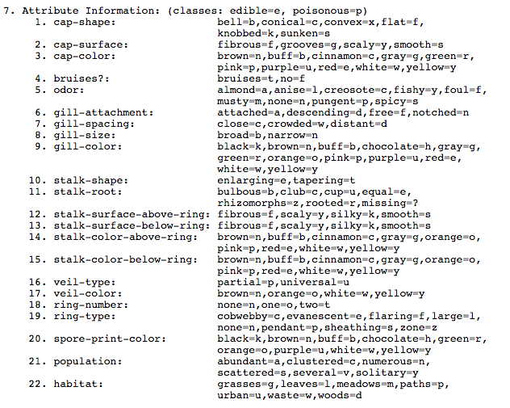
Appendix: Mushroom Attribute Information

